Slide 1

Resource Aware Programming for Sensor Networks
Matt Welsh mdw@eecs.harvard.edu
Harvard
School of Engineering
and Applied Sciences

Slide 2
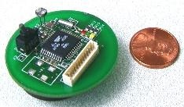
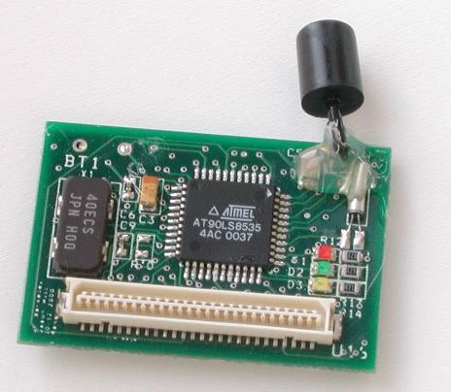
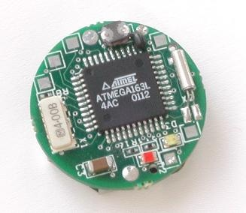
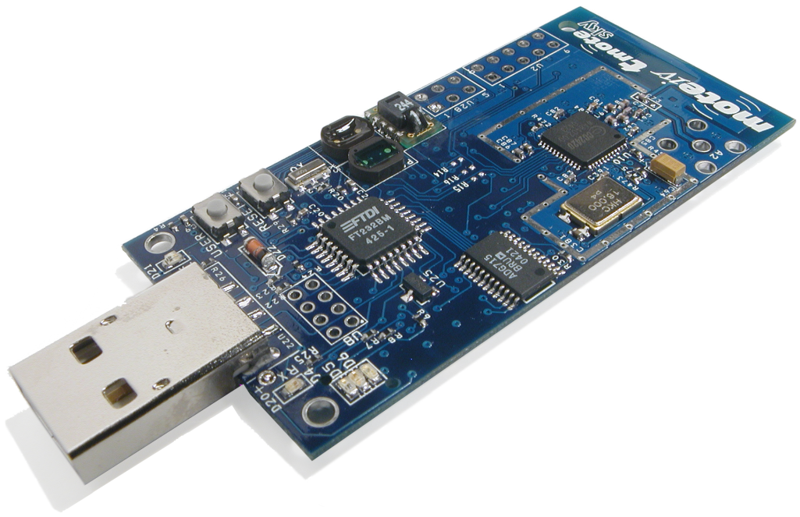
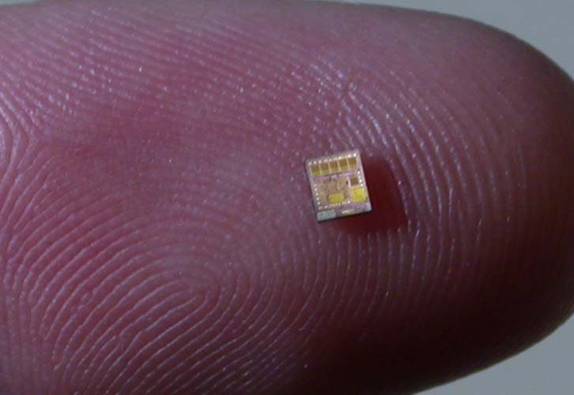
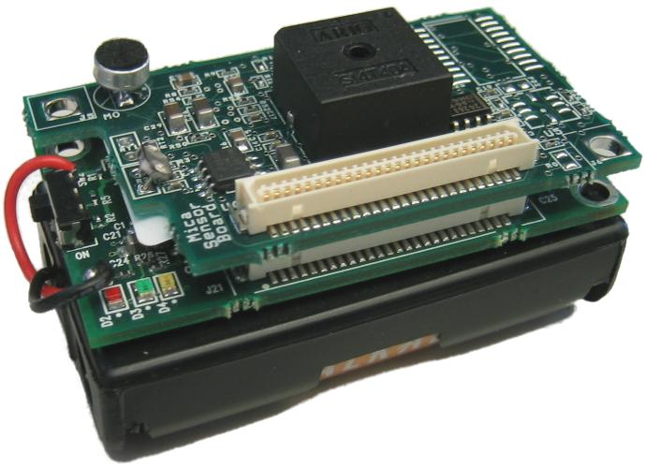
Sensor Networks: A New Computing Platform
Embedded devices integrating a modest amount of computation, communication, and sensing
Typical “mote” hardware
8 MHz CPU, 10 KB RAM, 60 KB ROM
Low-power radio (IEEE 802.15.4 – 250 Kbps PHY rate)
Various sensors (light, temp, humidity)
Cost: Around $75
Designed for low power consumption:
25 mA active (CPU+radio); 1.8 uA sleep
WeC (1999)
Rene (2000)
Dot (2001)
Telos (2004)
Speck (2003)
MICA (2002)

Slide 3
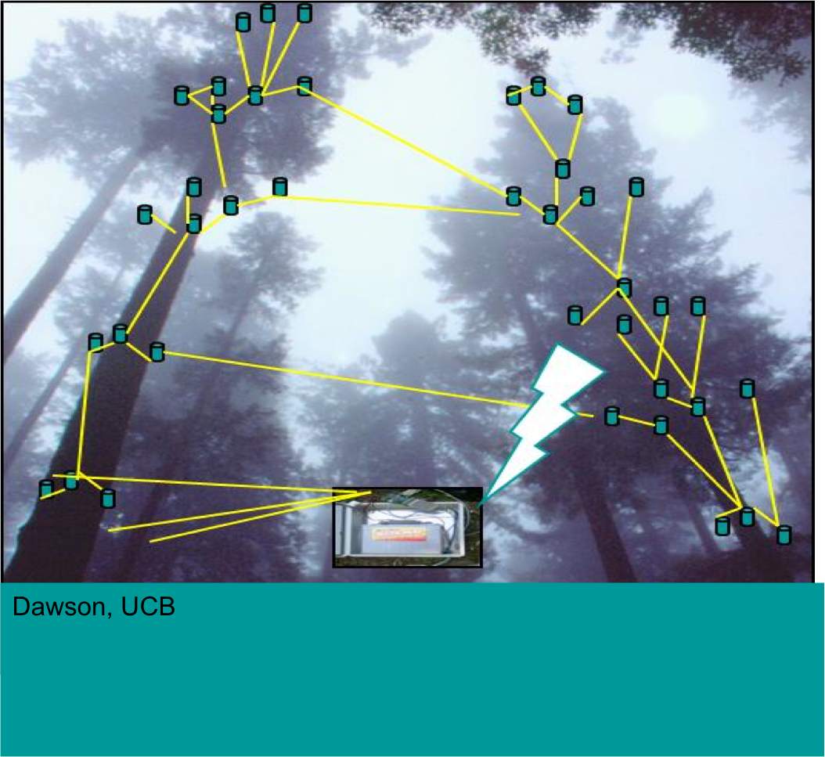
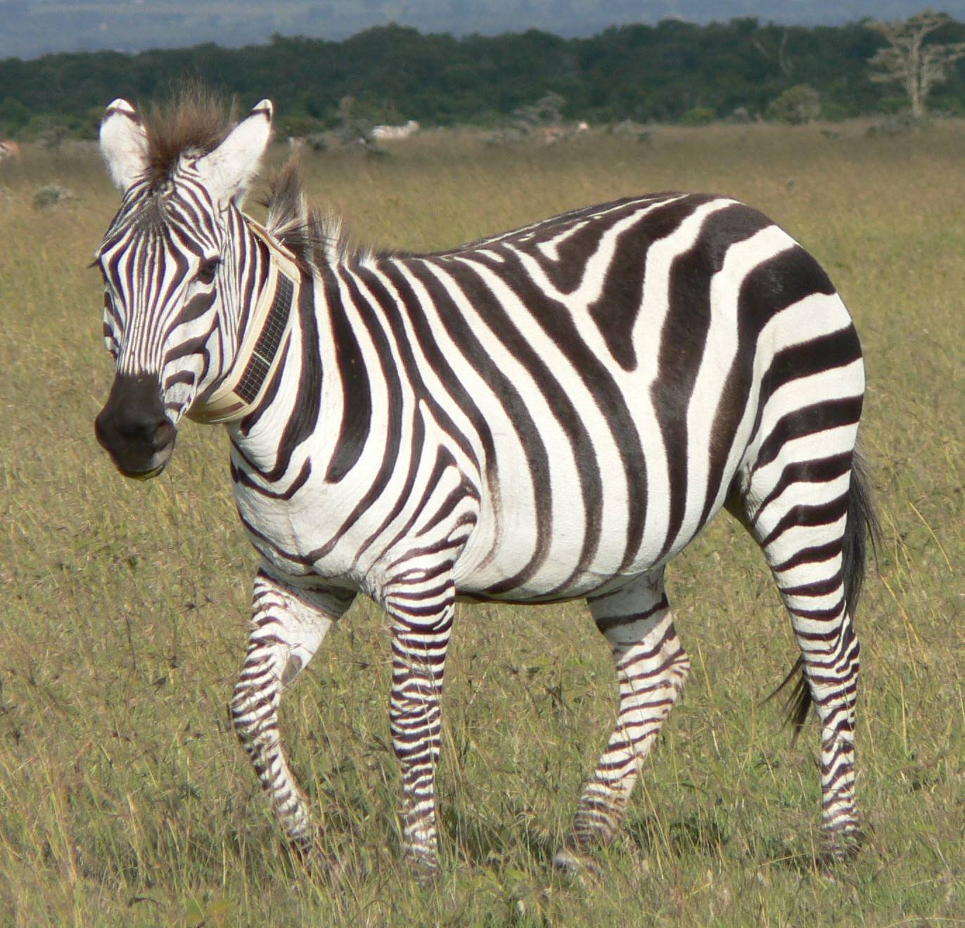
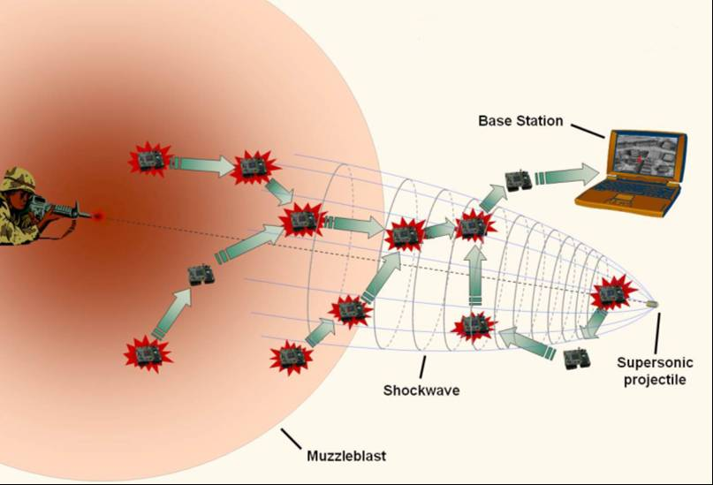

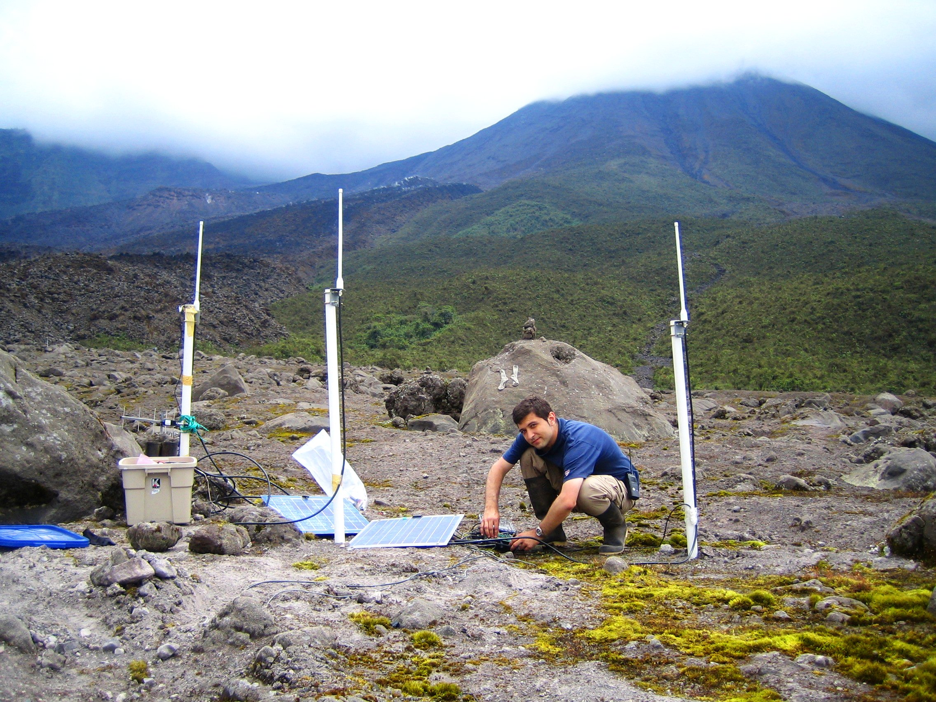

Lots of exciting application domains…
Vanderbilt
Princeton
Berkeley
Berkeley
Harvard
JHU/Harvard
Notes:
Just pictures here – no details.

Slide 4
Key Challenge: Resource Management
Sensor nodes are severely resource constrained
8 MHz CPU
10 KB of memory
~100 Kbps of radio link bandwidth (best case)
200 mAh – 2000 mAh batteries
Demands new approach to software design
Careful management of resources at the node level
Adaptation to changing load and resource availability
Coordination of resource allocation across the network
Our mantra: Resource Aware Programming
Make resources a first class primitive in the programming model.

Slide 5
Talk roadmap
Two application vignettes.
Elucidation of key challenges.
Pixie: An OS design for resource-aware programming
Lance: A framework for network-wide resource management.
Future vision and wrap-up.

Slide 6

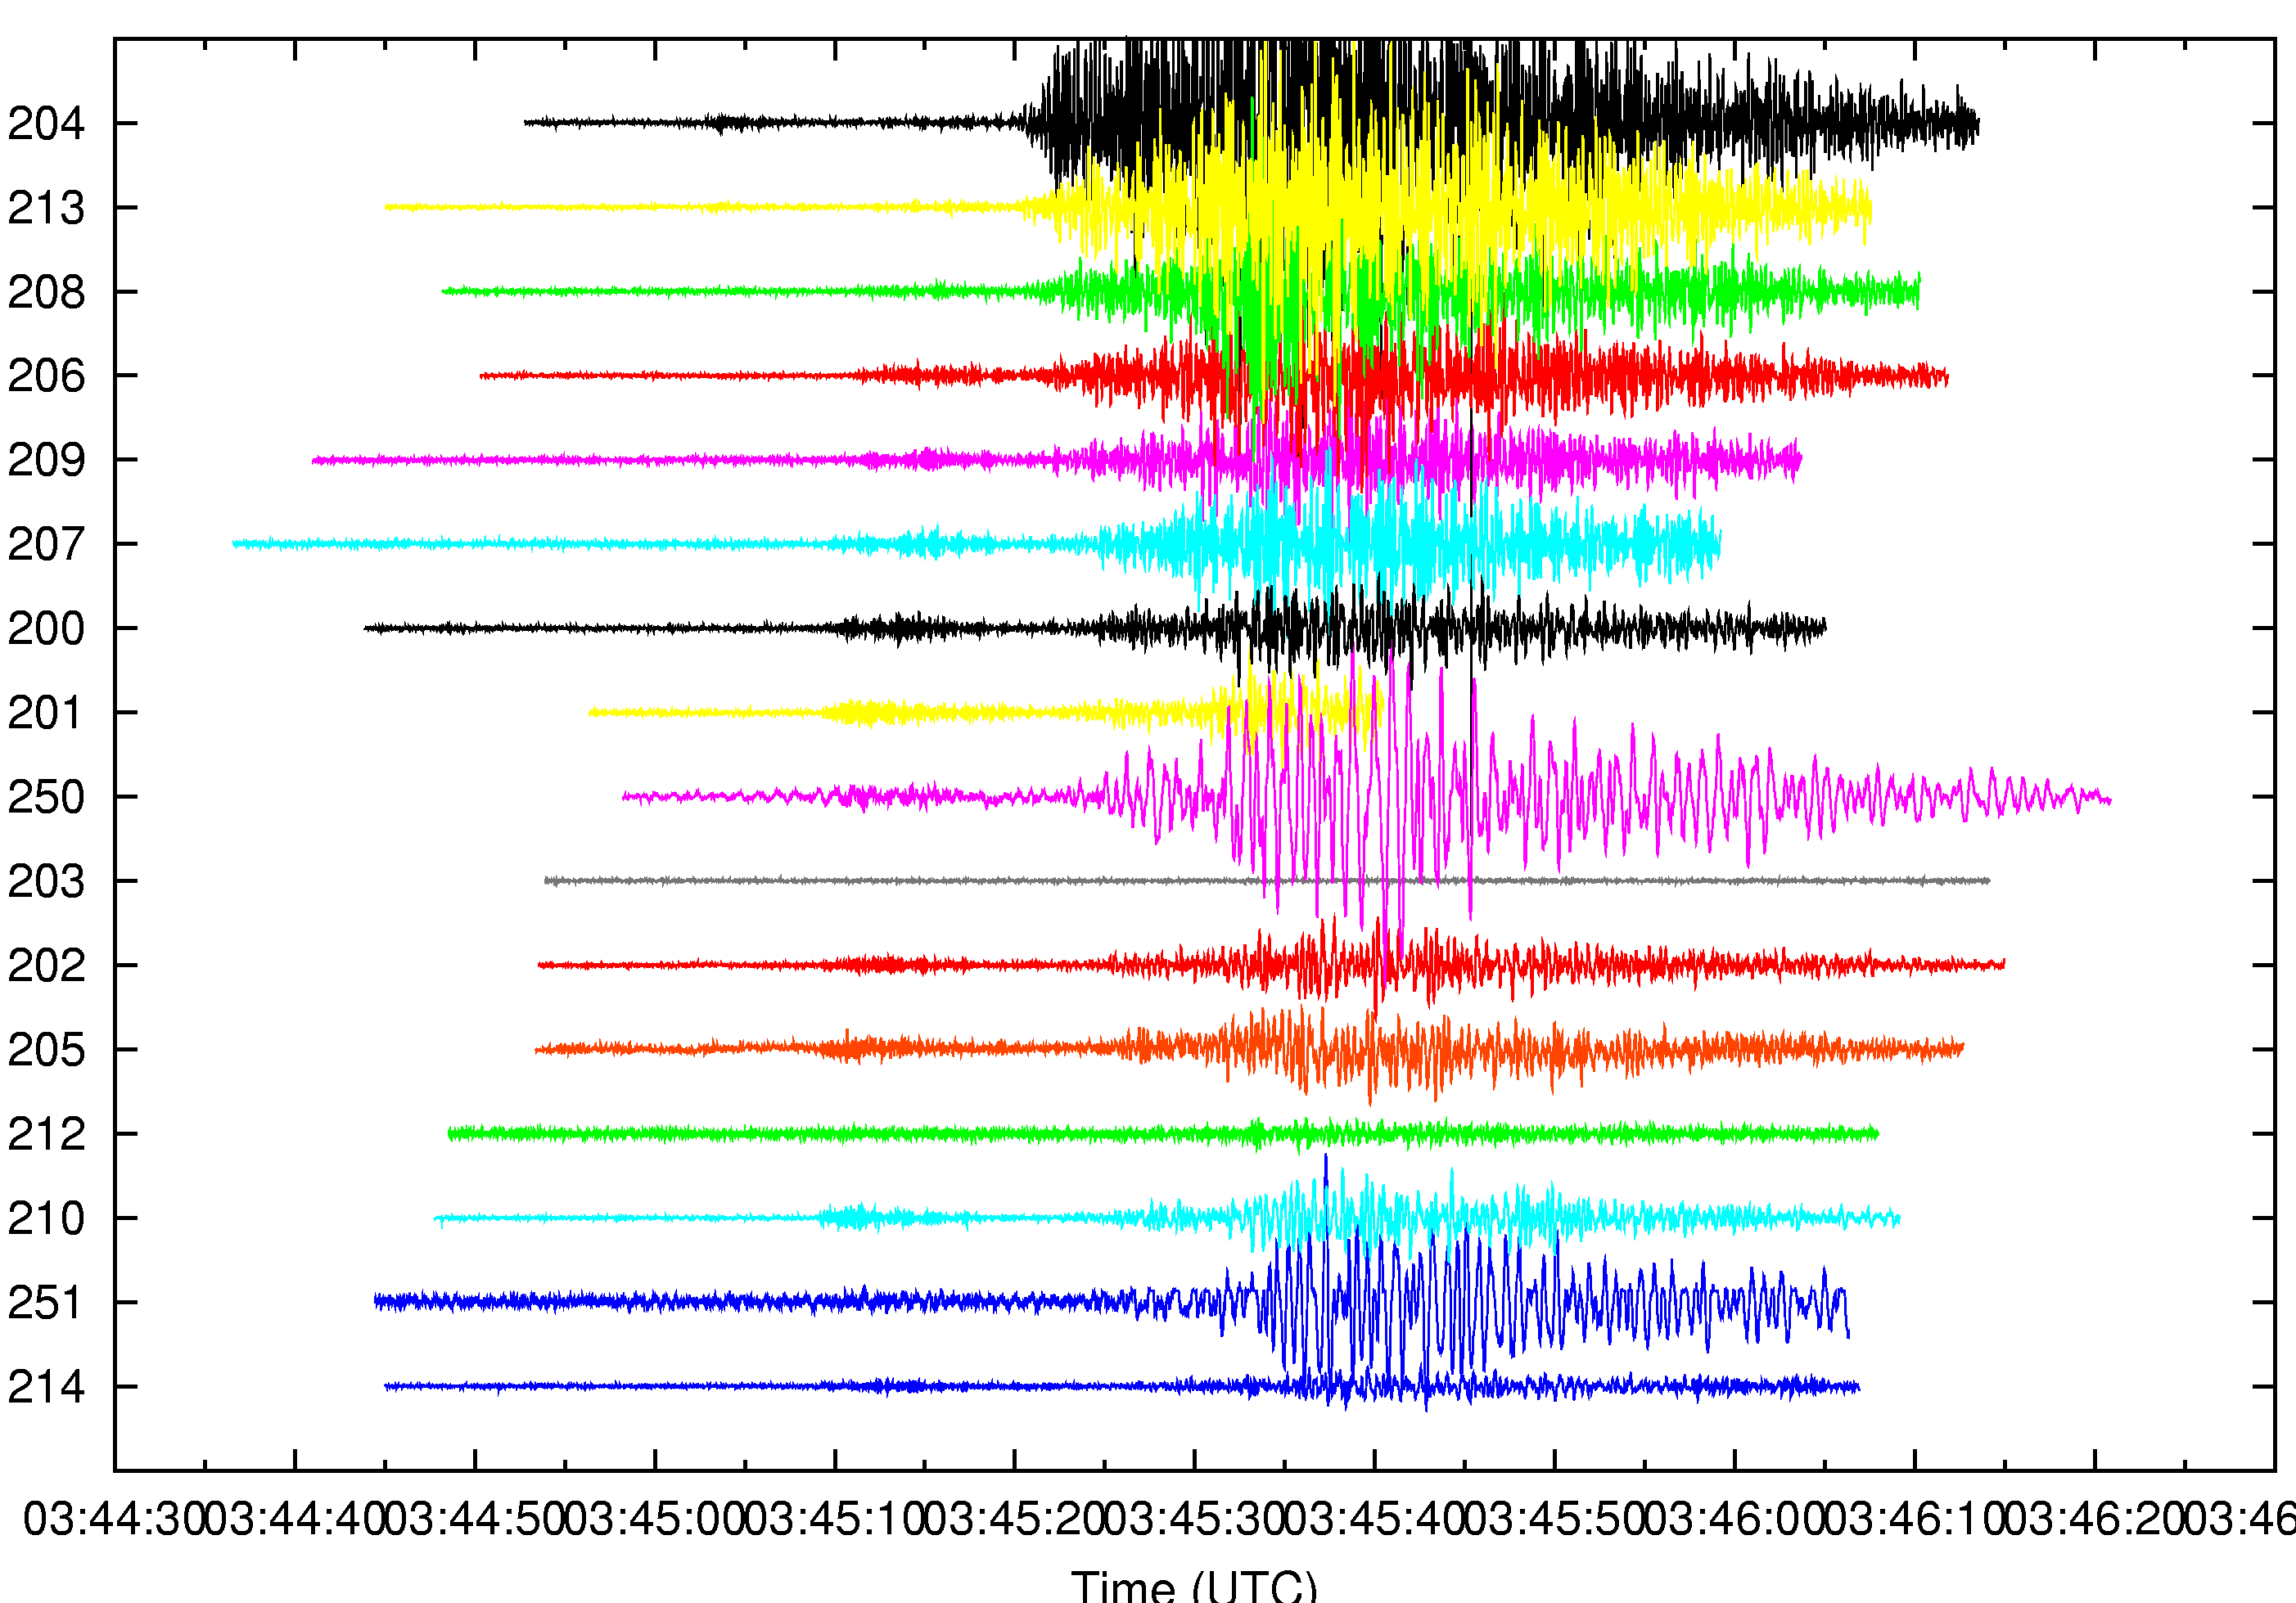

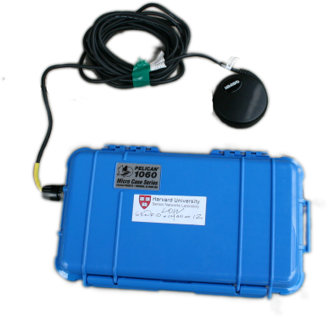
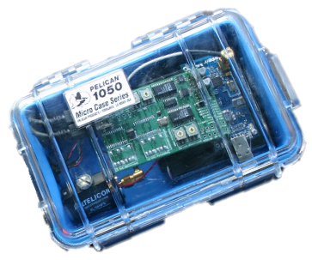
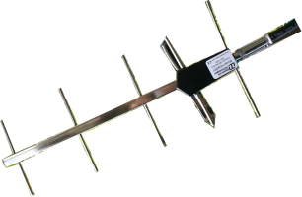



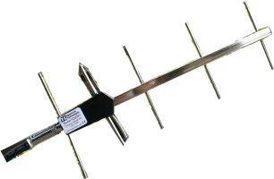
Application Vignette: Wireless Sensors for Volcanic Monitoring
Nodes continuously monitor seismic and acoustic signals,
sampling at 100 Hz.
1) Earthquake or eruption occurs
2) Nodes detect seismic event
3) Each node sends event report
to base station
4) 60 sec of seismic/acoustic data
downloaded from each node
GPS receiver
for time sync
Base station
at observatory
FreeWave
radio modem

Slide 7
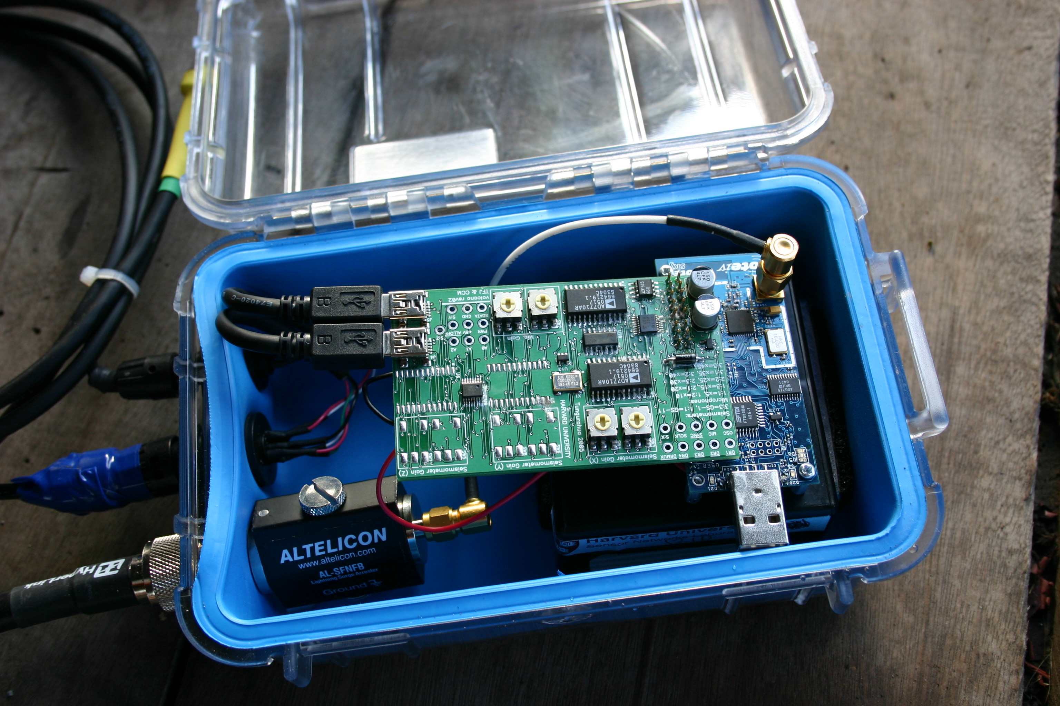
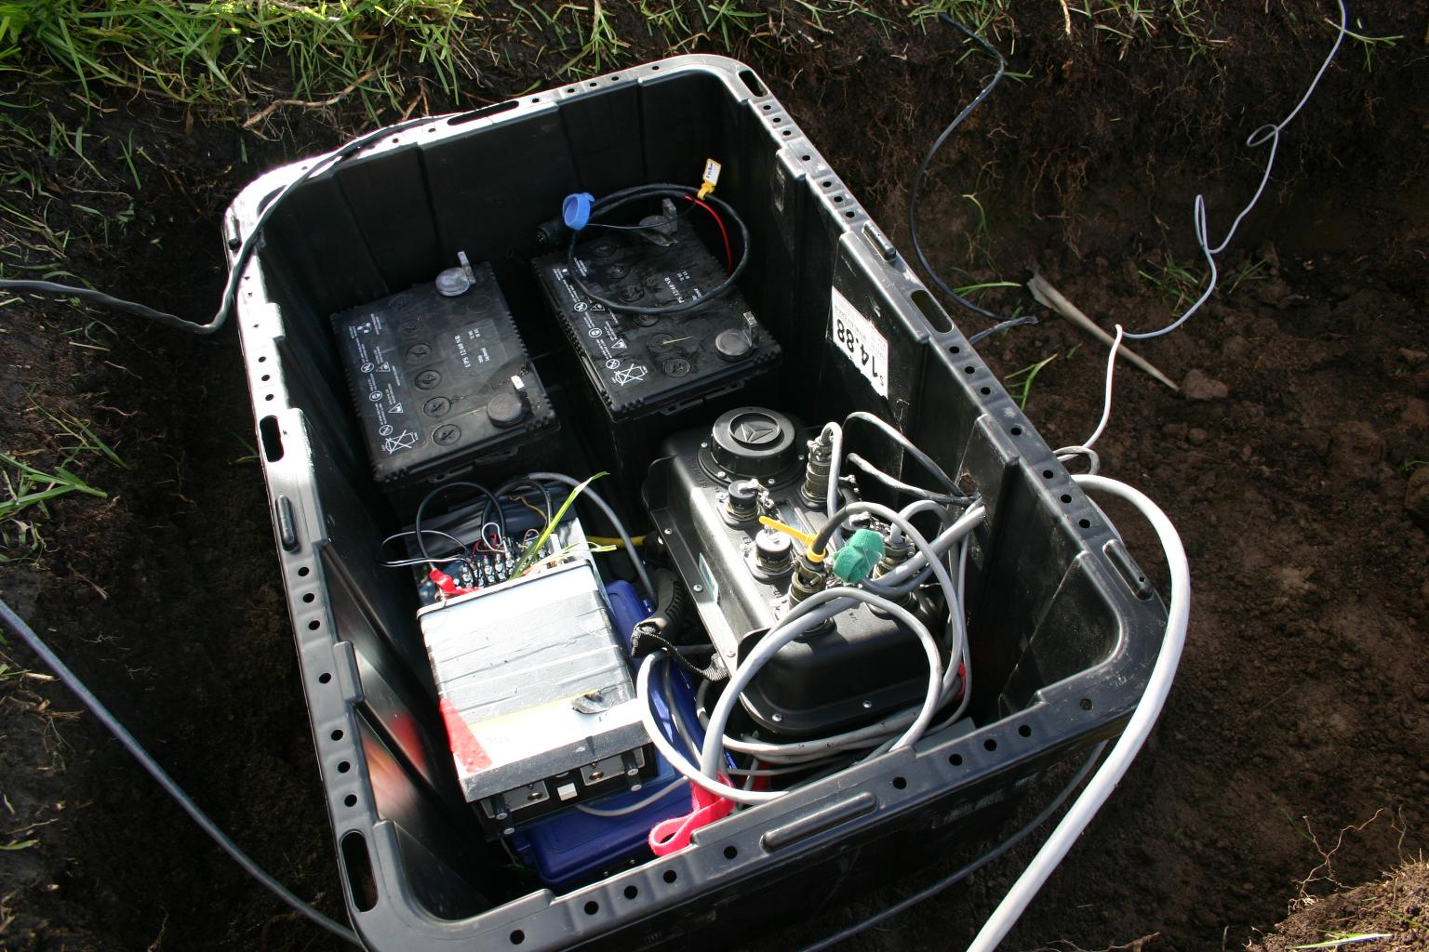
Reventador Volcano, Ecuador, August 2005
Four-channel
sensor node
Trusty grad student
Radio modem
GPS receiver
Solar panels for charging
car battery (used by
FreeWave and GPS only)‏

Slide 8
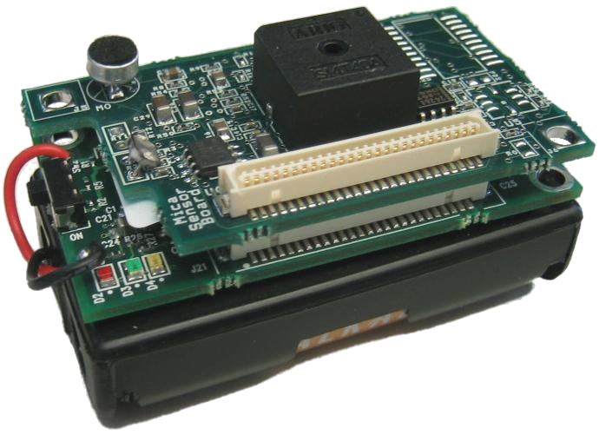
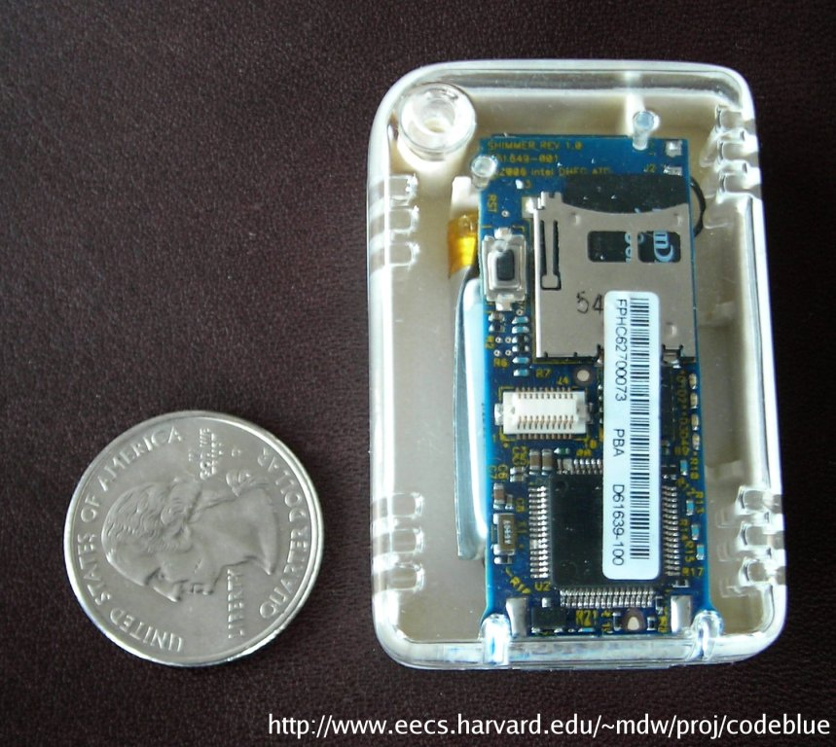
Parkinson’s Disease, stroke, and epilepsy monitoring with P. Bonato, Spaulding Rehabilitation Hospital
High-fidelity monitoring of limb motion
Triaxial accelerometer, triaxial gyroscope
6 channels per node, 100 Hz per channel
Full resolution signal exceeds radio bandwidth
Store raw data to flash (2 GB MicroSD)‏
Nodes perform local feature extraction
RMS, jerk, dominant frequency, other features...
Computationally intensive processing
Requires communication (e.g., time sync, and signal correlation across nodes)‏
Offline classification to map features to clinical scores
Motion sensors
SHIMMER mote

Slide 9
Things to notice about these applications...
High data rates with fine-grained time synchronization requirements
100 Hz sampling rate, multiple channels per node
Timing accuracy is paramount to support signal processing!
Fairly complex domain-specific processing:
P-wave arrival computation, velocity model to extract earthquake locations
Domain-specific feature extraction and classification of motion sensor data
Applications should adapt to changing resource availability
e.g., Variations in sensor data, changing energy reserves, or fluctuations in radio bandwidth
Adaptation is also highly application-specific

Slide 10
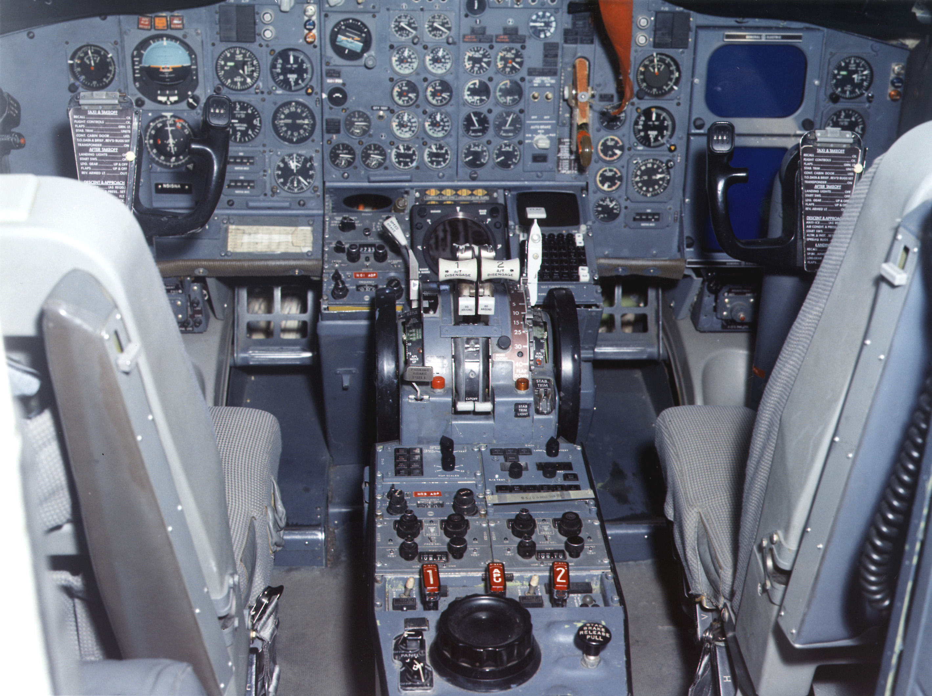
Resource tuning in TinyOS
Sampling rate
Interval
Many control knobs scattered throughout
App Control
Heartbeats
Data fidelity
ETX threshold
Drip
CTP
FTSP
Refresh rate
Refresh rate
Update interval
Active messages
Multiple components with complex wiring
Framing
Activity threshold
Data processing
Processing rate
Queue
Buffer mgmt
Log
Queue size
Pool size
Buffer size
LPL MAC
Filter
Queue
LPL interval
Notch frequency
Queue size
Radio driver
ADC driver
Flash driver
LED driver
Timer
Tx power
DMA threshold
Write timeout
CC2420
ADC
Flash
LEDs
Clock

Slide 11

What we really want

Slide 12
Our Approach: The Pixie Operating System
Pixie is a new operating system for sensor networks that supports:
Resources as a first-class programming primitive
A resource aware programming model based on resource tickets and brokers
Pixie is intended to make it easy to write adaptive applications
With such limited sensor node resources, application must contend with varying resource conditions!
Fundamental challenge:
How to enable resource awareness without placing undue burden on the programmer?

Slide 13
Sample Application: Motion Analysis
Each stage performs computation or I/O
Decimate
RMS
Sampling
Activity Filter
Radio Link
Peak Amplitude
Do some computation
Drop
Autocorrellation
FlashStorage
Queues are optional
request(700mJ, 10sec)
Ticket
request(2 packets, 5 sec)
Ticket
<Energy, 700mJ, 10sec>
Pixie Energy Allocator
Bandwidth Allocator
Energy Estimator
Bandwidth Estimator

Slide 14
Resource Tickets
Core abstraction for resource management in Pixie
Ticket <R, c, t_{e}> represents a revokable right to consume c units of resource R until the expiry time t_{e}.
Think of as a short-term “reservation” for some resource.
Tickets decouple resource request from usage – permits planning.
Basic resource ticket operations:
Redeem: Consume resources indicated by ticket
Forfeit: Give up ticket
Revoke: Reclaim resources (can happen prior to expiry time!)
Join: Combine two tickets into one
Split: Split a ticket into two separate tickets
Granularity depends on resource variability
e.g., Bandwidth tickets would have a short expiry time; storage tickets need not expire.

Slide 15

Tickets are not guarantees!
Making strict guarantees about resource reservations is difficult:
System cannot promise that a given resource will be available when needed.
e.g., radio bandwidth can fluctuate considerably due to ambient conditions, cross traffic, and node mobility.
Pixie tickets are revokable, even before the expiry time
Trade off efficiency for ease of use.

Slide 16
Resource Allocators
Each physical resource has a corresponding allocator
Allocators for energy, memory, flash storage, and radio
Implicit allocator for CPU – the scheduler
Allocators estimate available resource, and allocate tickets.
No policy: Always allocate ticket if the resources are available
Policies handled by higher-level abstractions (e.g., brokers)
Allocators also enforce ticket redemption
e.g., To transmit a packet must have corresponding bandwidth ticket

Slide 17
Resource Brokers
Resource tickets are intended to be low-level and fine-grained
Very flexible and powerful, but sometimes difficult to use
To simplify app design, we introduce resource brokers
Brokers request and manage resource tickets on behalf of the application
Each broker implements some policy and provides a high-level API to the app
Brokers are specialized stages
Can interpose directly on the application’s dataflow path
Can inspect, redirect, discard, or refactor data
Pixie provides a small library of standard brokers

Slide 18
Bandwidth Broker
Decimate
(20 pps)
<nominal rate>
RMS
(6 pps)
Sampling
Activity Filter
Bandwidth
Broker
Radio Link
6pps
4pps
2pps
Peak Amplitude
(4 pps)
<nominal rate>
Autocorrellation
(2 pps)
FlashStorage
request(20 packets, 1 sec)
12pps
Bandwidth Allocator
Bandwidth Estimator
12 pps

Slide 19
The Pixie Energy Broker
C
Energy debt
Conservative strategy
Nominal energy schedule
Battery
capacity
Surplus
Reduce ticket allocations
ρ = C/LTT
Increase ticket allocations
time
LTT
Lifetime target

Slide 20


Evaluation: Acoustic Target Detection
Detect acoustic signature of target (marmot call) in acoustic signal, subject to variable noise.
Similar to ENSBox [Girod et al. Sensys’06] – but no ranging
Three detection algorithms with increasing energy cost and accuracy
Goal: Maximize accuracy subject to battery lifetime target
High energy cost, very accurate
FFT detector
24 kHz acoustic
sampling
Drop if quiet
Energy switch
High-pass detector
Transmit detection
Threshold detector
Low energy cost, many false positives

Slide 21
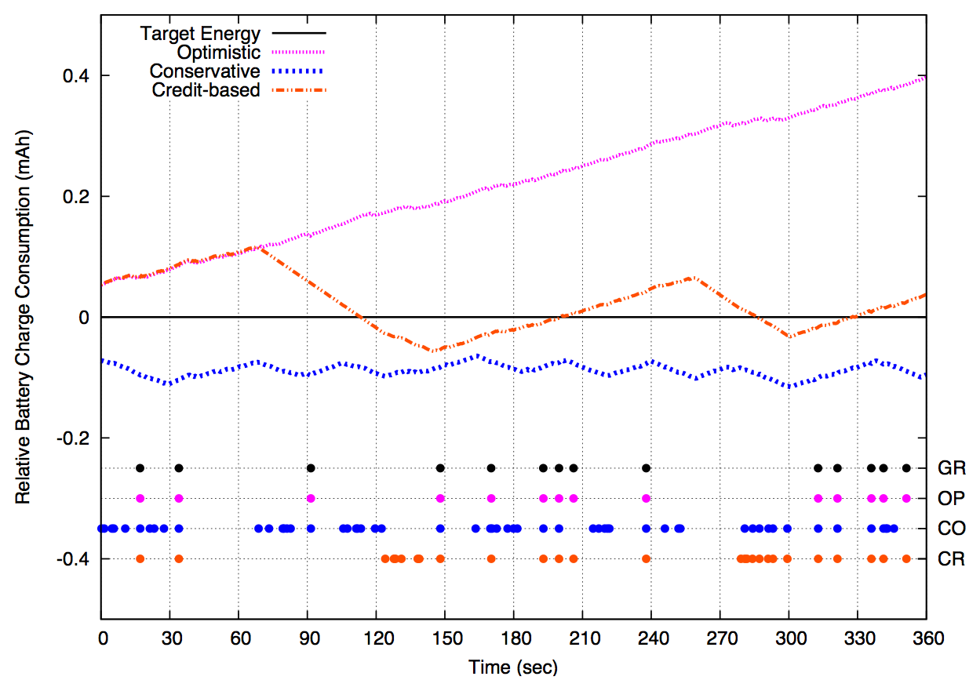
Energy adaptivity: Varying policies 40-day lifetime target
Optimistic policy:
Does not meet schedule…
Credit-based policy: Incurs limited energy debt
Debt payback: Threshold
Normalized to target energy schedule
Conservative policy:
Maintains schedule
Adequate energy: FFT
Dots represent target detections (including false positives)
…But is 100% accurate
Lots of false positives
Much more accurate
Ground truth
Optimistic
Ground truth
Conservative
Credit-based

Slide 22
Network-Wide Resource Management
Large sensor networks constrained in two important ways:
Bandwidth: Reliable data transfer is very slow.
Energy availability: Even if bandwidth were plentiful, can’t run radios all the time.
To optimize data fidelity, need to carefully manage resources across the network as a whole.
Let’s focus on one key problem: Reliable signal collection

Slide 23

The Problem
4800 b/s > 512 b/s
data generation rate > available network capacity

Slide 24
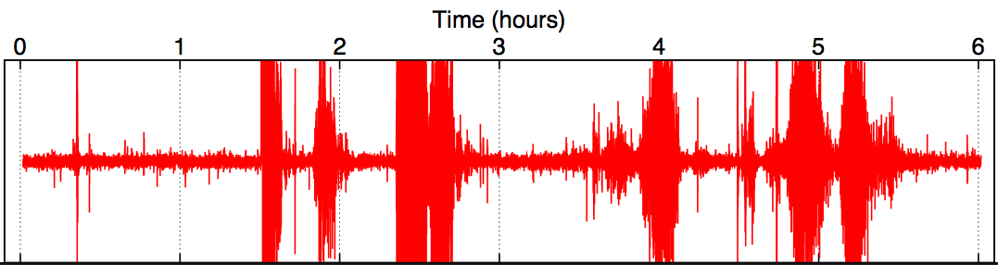
Observation: Data Differs in Value
Small
Earthquake
Noise
Large
Eruption
Large
Eruptions
Large
Eruption
Large
Eruptions
interesting data

Slide 25
Observation: Data Differs in Cost
7
6
2
4
5
1
3
B
Bandwidth to Node 1:
2048 Bytes/sec Energy cost: 522 mJ
Bandwidth to Node 7:
512 Bytes/sec
Energy cost: 6106 mJ

Slide 26

Our Approach: Lance
System for priority driven allocation of bandwidth and storage resources within a sensor network
Goal: Optimize data quality subject to energy and bandwidth constraints
Lance decouples mechanisms for resource allocation from app-specific policies
App-supplied policy modules permit a wide range of allocation policies to be implemented
Can target many optimization metrics: priority maximization, fairness, spatial/temporal data distribution, and more

Slide 27
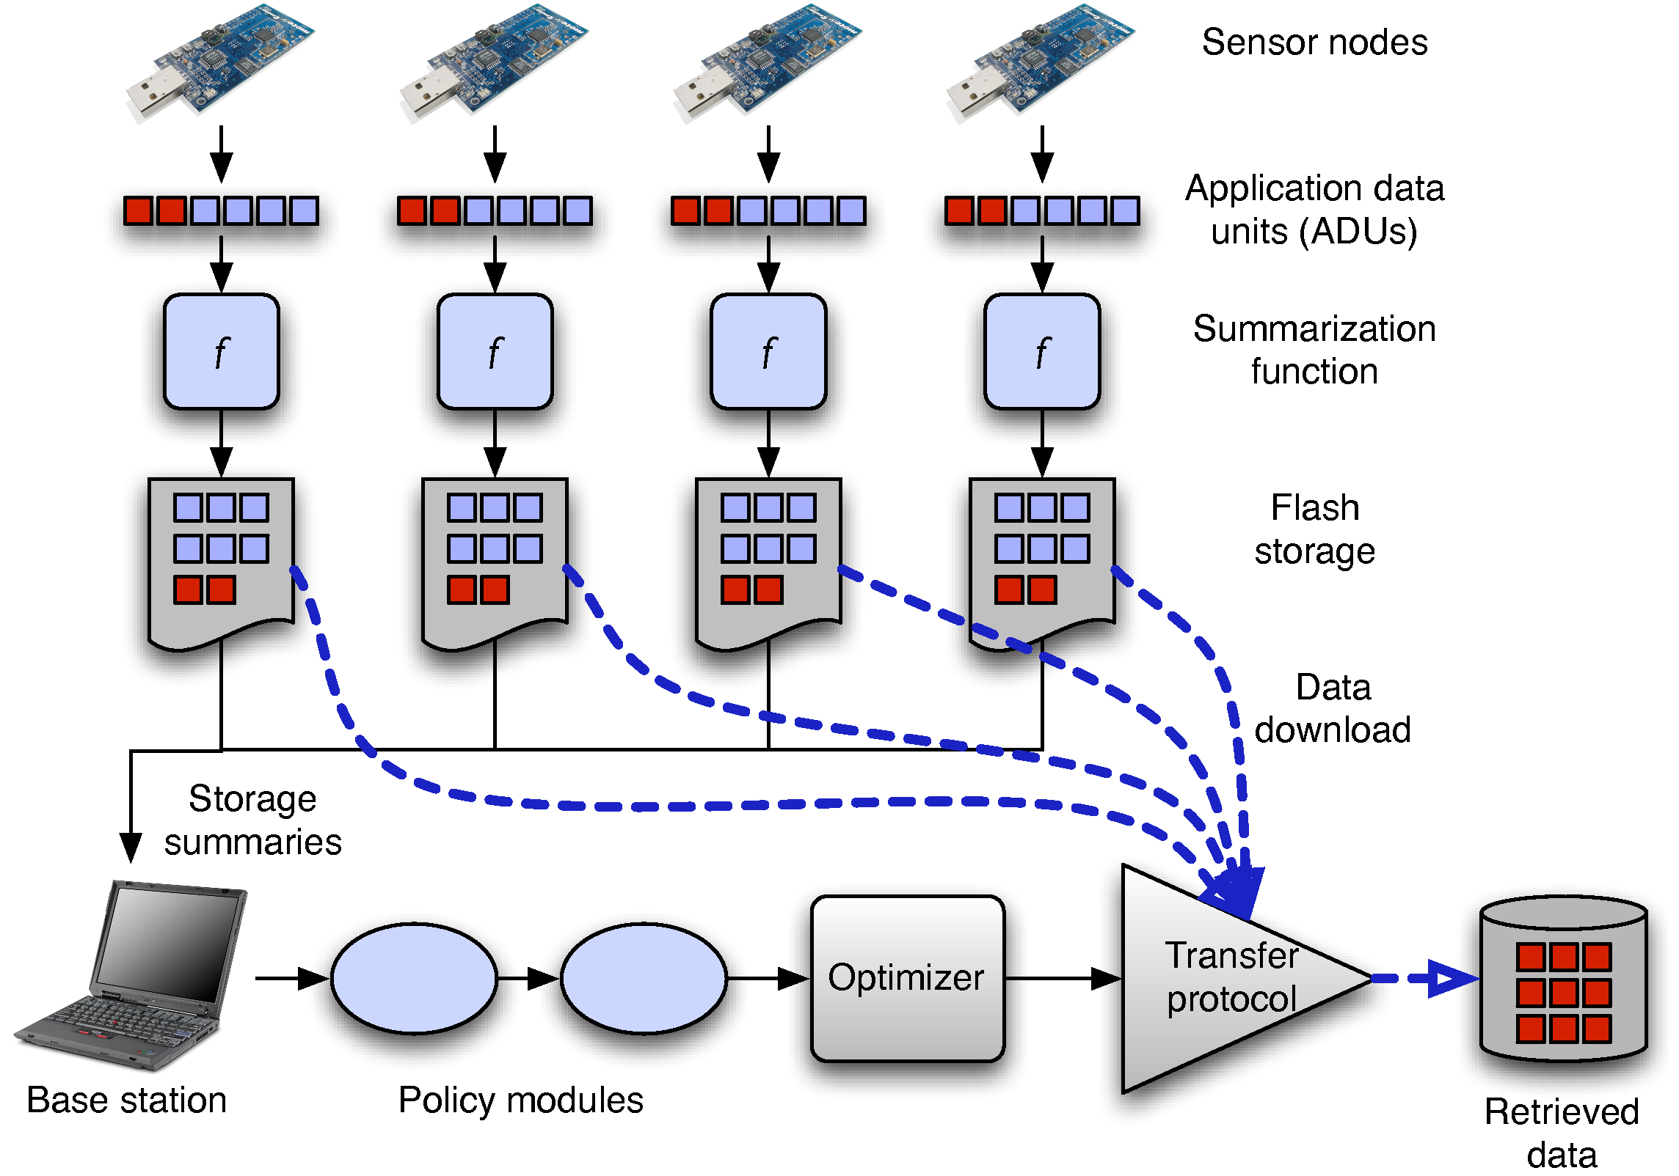
Lance System Architecture

Slide 28
Lance System Architecture
1) Nodes sample data to ADUs
Application Data Unit:
Chunk of data sampled from single node
Example:
60 seconds of 100Hz seismometer data = 18kB

Slide 29
Lance System Architecture
2) Nodes compute summary for each ADU

Slide 30
Lance System Architecture
2) Nodes compute summary for each ADU
3) Summaries sent to base station

Slide 31
Lance System Architecture
4) ADUs logged to Flash

Slide 32
Lance System Architecture
5) Base station scores ADUs, downloads top scoring ADU from network

Slide 33
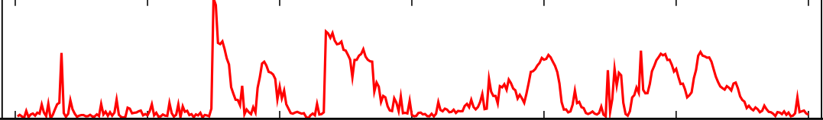
Defining Data Value
Assumption: nodes compute initial value for each ADU.
This determination is inherently app-specific
Raw signal
Reduced
Seismic
Amplitude
Measurement
(RSAM)

Slide 34
Optimization Goal
U = Set of all possible ADUs
E = Vector of energy capacity of each node
c(u), v(u) are the cost and value for each ADU u
The optimal set u_{o} is the set of ADUs maximizing
∑ v(u_{o}) subject to ∑ c(u_{o}) < E
Offline Solution: Multidimensional Knapsack Problem

Slide 35
Optimization Strategy
Achieving optimal behavior requires complete knowledge of all data sampled by nodes over time.
We need an online greedy approximation.
Algorithm operates as follows:
1) Assign a score to each ADU currently stored by the network
We explore three separate scoring functions (next slide)
2) Exclude data stored on nodes without enough energy:
Given battery capacity C and lifetime target L, require node consume energy at a rate no greater than C/L.
Model energy cost for data download, routing, and overhearing on nearby nodes.
3) Download the ADU with the highest score.

Slide 36
Energy Cost for Data Collection
Empirically measure:
e_{d}: the energy drain during downloading (58 mJ/s)
e_{r}: the energy drain during routing (55 mJ/s)
e_{o}: the energy drain during overhearing (6.6 mJ/s)
7
6
2
4
5
1
3
B

Slide 37
Energy Cost for Data Collection
Empirically measure:
e_{d}: the energy drain during downloading (58 mJ/s)
e_{r}: the energy drain during routing (55 mJ/s)
e_{o}: the energy drain during overhearing (6.6 mJ/s)
7
6
2
4
5
1
3
B

Slide 38
Energy Cost for Data Collection
Empirically measure:
e_{d}: the energy drain during downloading (58 mJ/s)
e_{r}: the energy drain during routing (55 mJ/s)
e_{o}: the energy drain during overhearing (6.6 mJ/s)
7
c₇ = (0, 0, e_{r}, e_{o}, e_{r}, e_{o}, e_{d}) * t₇
6
2
4
5
1
3
B

Slide 39
Lance Scoring Functions
Inputs: ADU with value, cost vector
Output: Score used to rank ADUs
ADU₁: [v=10, c = (58, 6.6, 0)]
3
ADU₂: [v=20, c = (55, 58, 6.6)]
ADU₃: [v=40, c = (58, 58, 55)]
v=40
2
Three scoring functions:
Value only: Score ADU by its value alone
Cost total: Score ADU by value scaled by total cost to download
Cost bottleneck: Score ADU by value scaled by most energy-constrained node on routing path
v=20
1
v=10
B

Slide 40
Scoring function comparison 10-node linear chain
Data value retrieved (% of available)
Biased towards nodes near sink
Closely matches offline optimal solution
Downloads same amount of data from all nodes

Slide 41
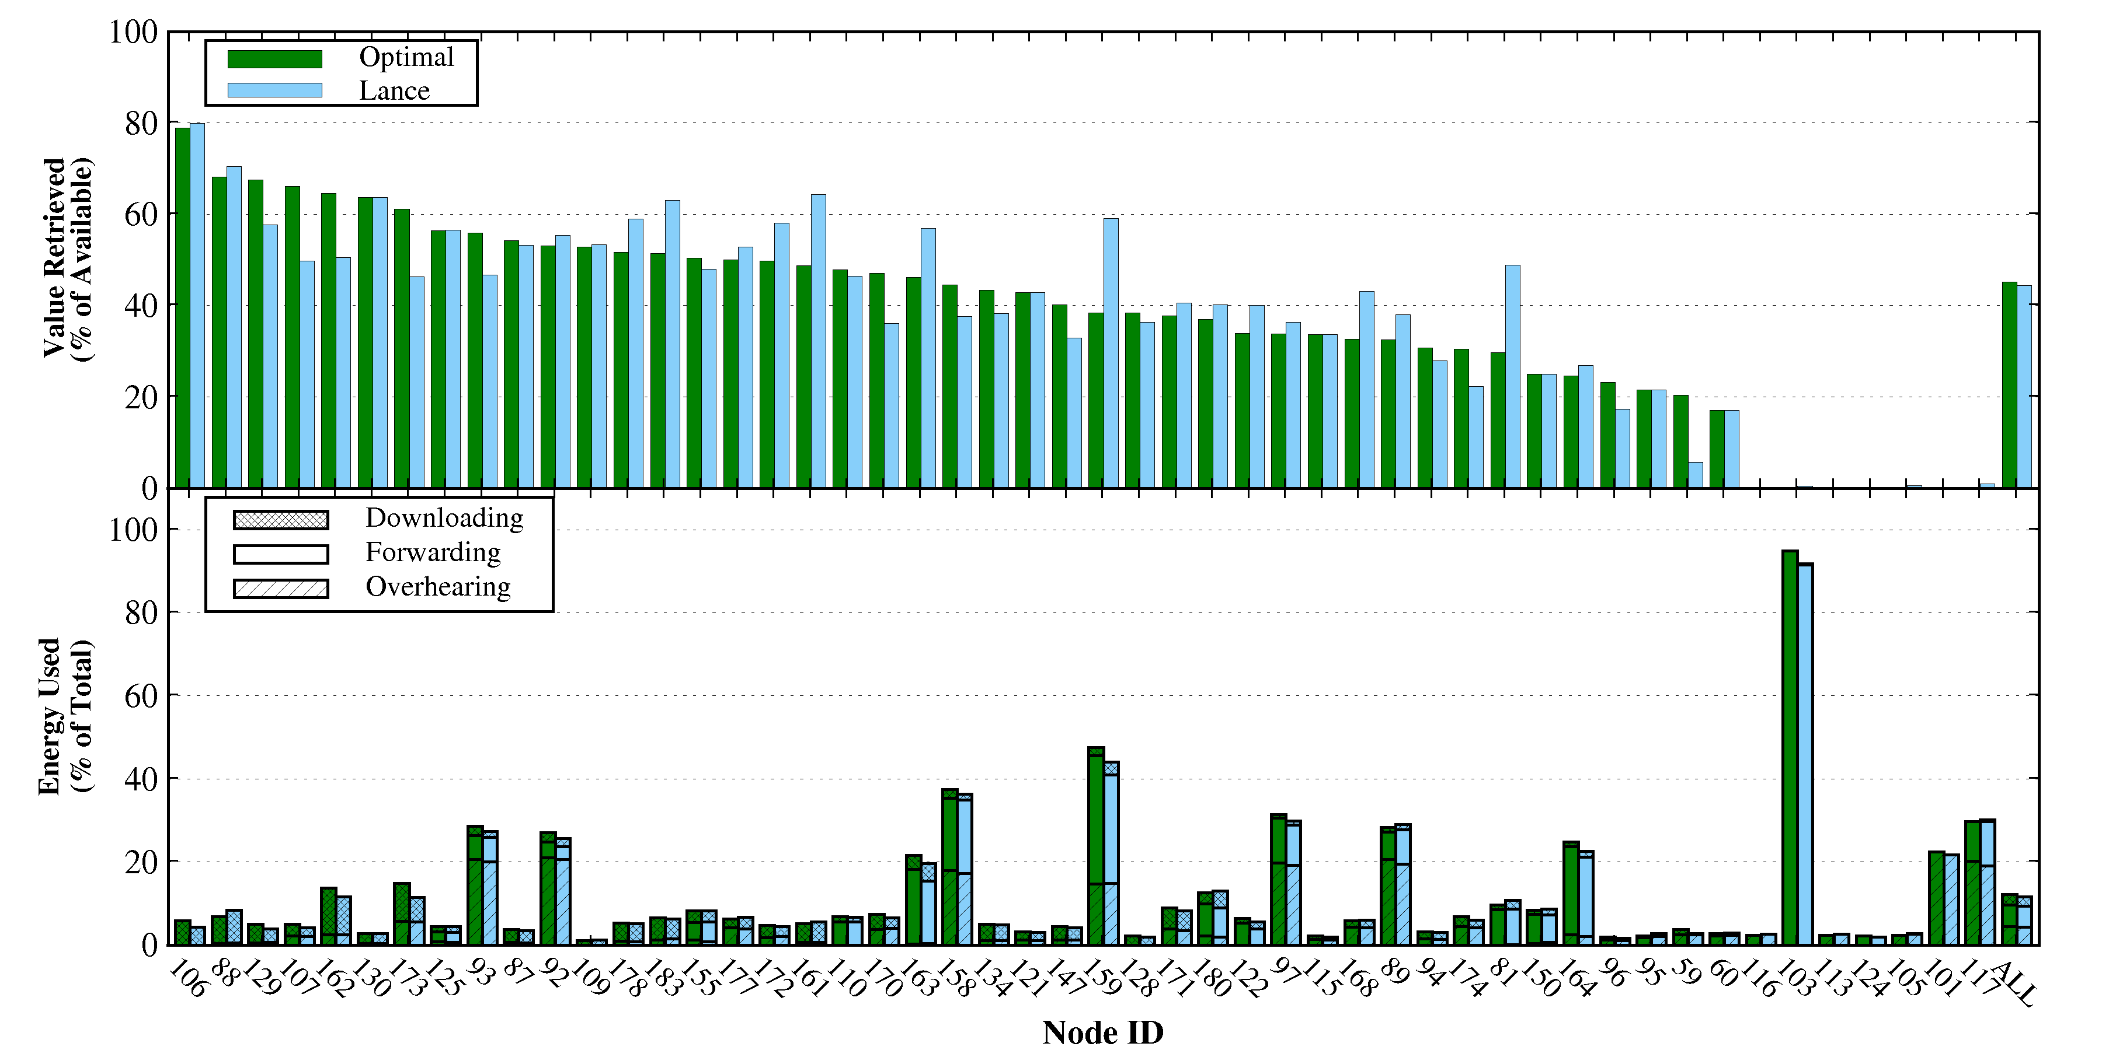
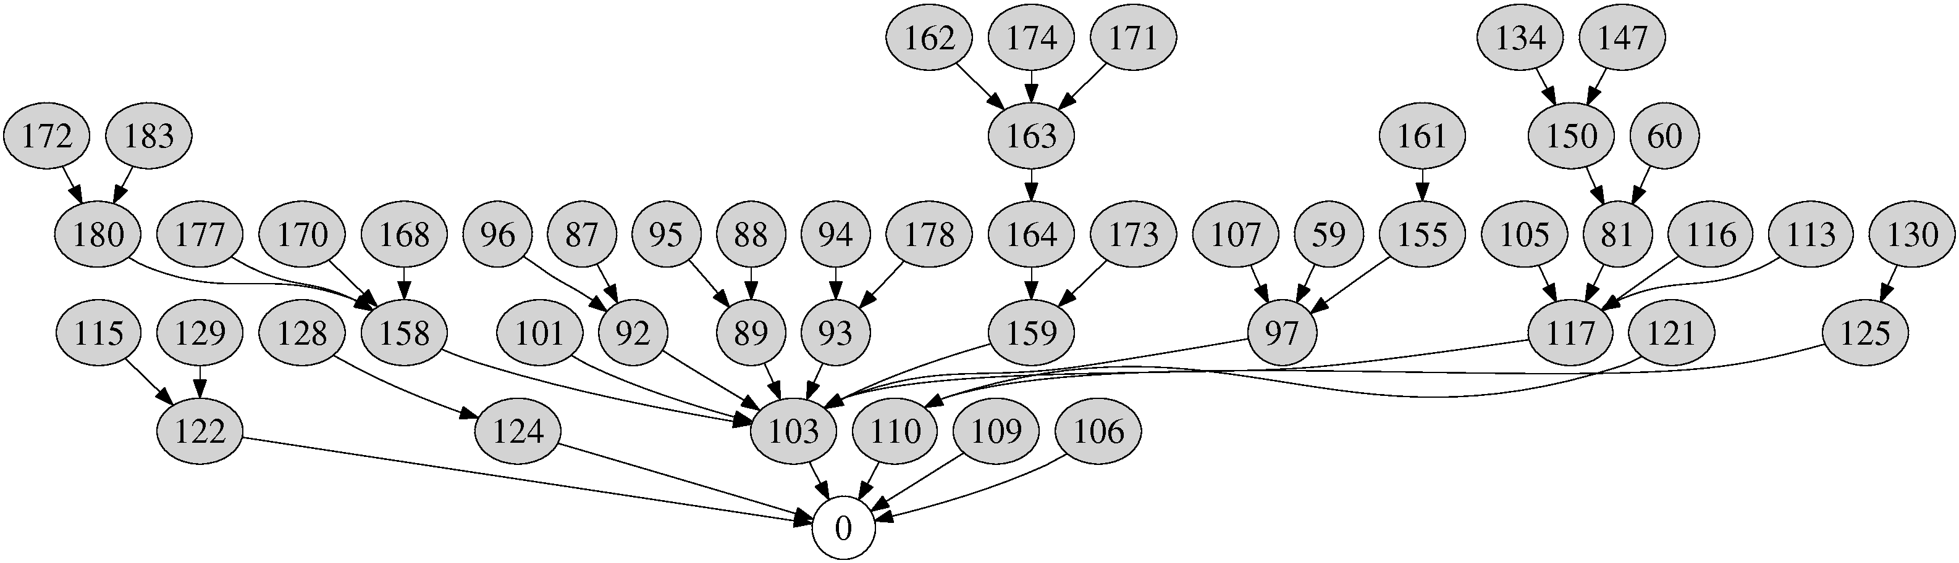
MoteLab Testbed Experiments 50 node tree topology, Zipf value distribution
Lance closely matches optimal behavior
Node ID
Total

Slide 42
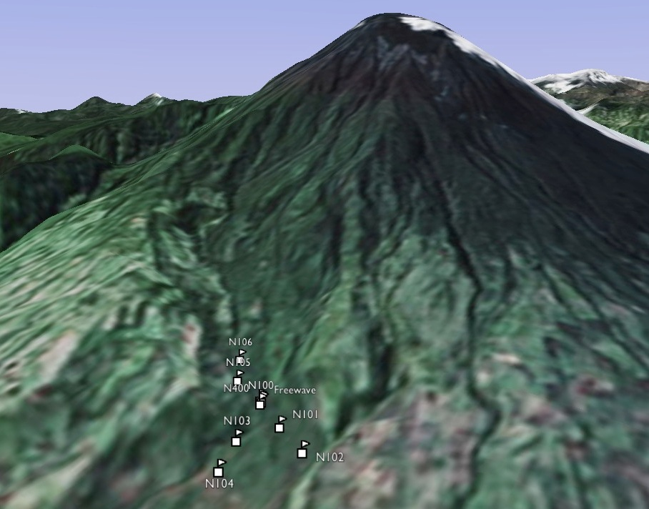
Tungurahua Volcano Deployment
Tungurahua field deployment,
August 2007
Tungurahua summit
8 km to observatory

Slide 43
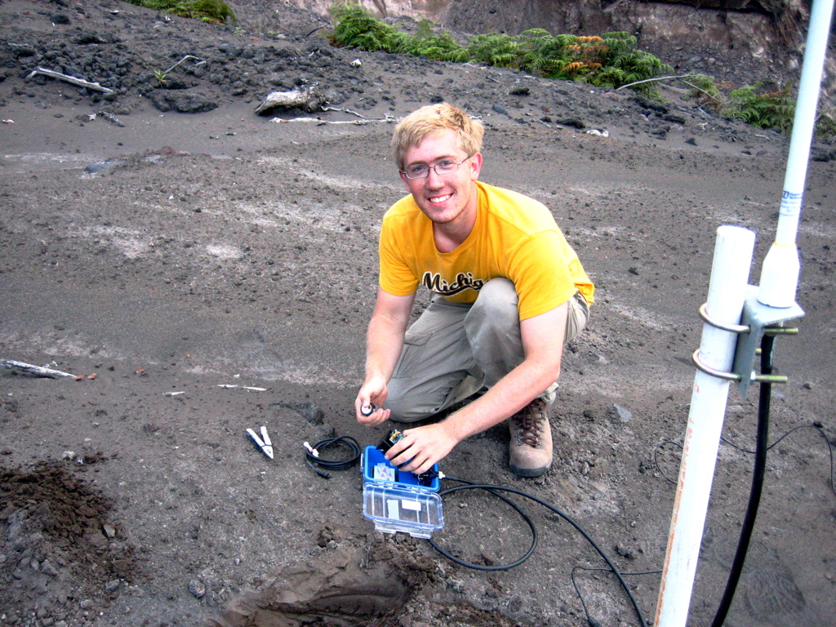

Slide 44
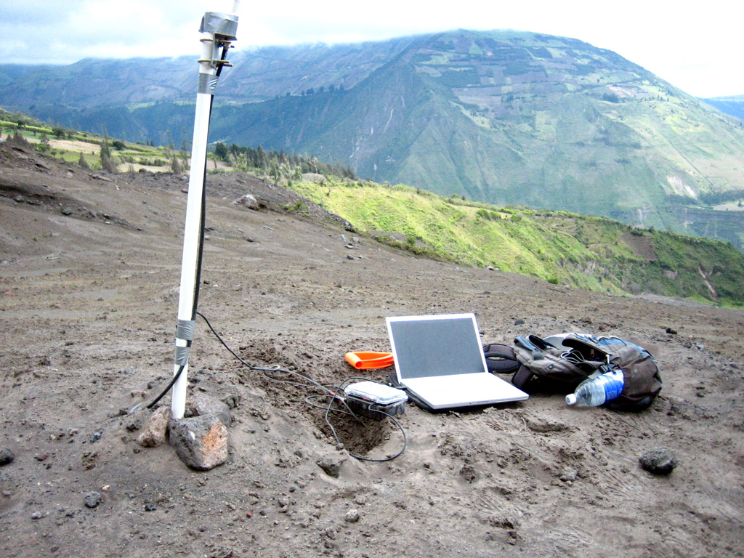

Slide 45
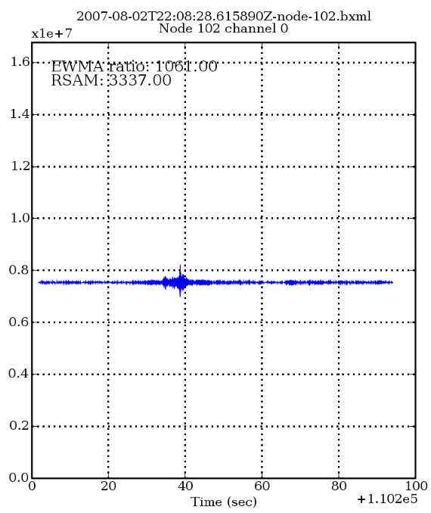
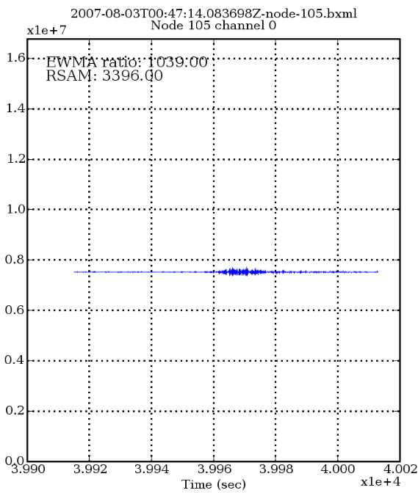
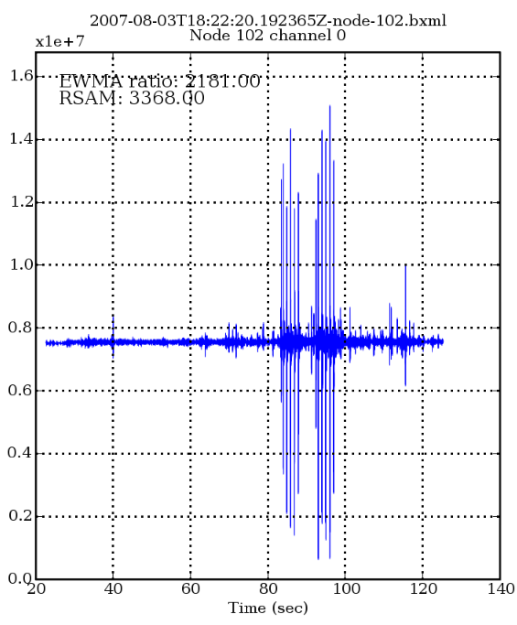
We fixed the volcano...

Slide 46
Deployment Results
Ran 8 sensor nodes for a total of 71 hours
Lance used to manage storage and bandwidth
Experimented with different prioritization functions and policy modules
Successfully downloaded 1232 ADUs (77 MB of data)‏
308 downloads failed due to timeouts: success rate 80%
Total storage summaries span 11012 ADUs (688 MB of data)‏
Lance downloaded 11% of the data acquired by the network
Lance downloaded 99.5% of the offline optimal data

Slide 47
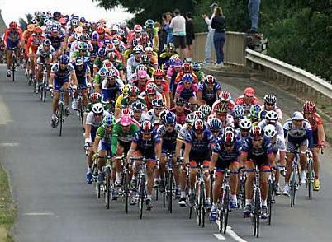
Future Directions: Peloton
What about coordinated resource management within the network?
Example: Group of nodes detect an event, elect leader to collect signals, process data, deliver results to the base station.
Nodes need to share information on resource availability, coordinate resource allocation decisions, and represent cross-node allocations
Peloton – A Distributed OS for resource-aware programming
Decentralizes resource management within the network
Extend Pixie’s abstractions to span allocations on multiple nodes.
[HotOS 2009]

Slide 48


Future Directions: RoboBees
NSF Expeditions in Computing
My group: Swarm OS for distributed resource management and programming models

Slide 49
Conclusions
Sensor networks have tremendous potential for data-intensive science, but resource management remains a significant challenge.
Too many low-level knobs that impact performance and lifetime.
We advocate resource-aware programming as a fundamental design principle.
Applications cannot hide from the need to manage and adapt.
Pixie provides OS abstractions for resource awareness at the node level.
Lance offers a framework for network-wide resource management.
These systems provide a great deal of flexibility and control to programmers, while hiding the complexity of low-level resource management.
For more information, papers, and code:
http://www.eecs.harvard.edu/~mdw

Slide 50
Related Work
Resource management primitives in sensor networks
Large amount of work in energy reduction: MAC protocols, routing, sensor duty cycling
ICEM, SNACK: Enable cross-component energy reduction
iCount, Quanto: Energy metering support
Programming model support for resource management
Eon, Levels: Tune energy consumption according to set policy
We provide same functionality through Pixie resource brokers
TinyDB: Lifetime-targeted queries
Mobile systems
Odyssey: Framework allowing applications to adapt to energy, bandwidth, and CPU
ECOsystem: Tune OS scheduling policy for battery lifetime targets
Puppeteer: Adaptation to bandwidth variation

Slide 51
Resource Estimation
Storage and memory are straightforward
Allocators track total flash/memory consumption
Bandwidth: Radio link estimates packet transmission delay
Measure total time for packet transmission plus ARQ (if used)
Invert transmission delay to estimate instantaneous bandwidth
Maintain separate estimate for each neighbor
Currently assumes delay is independent of packet size

Slide 52
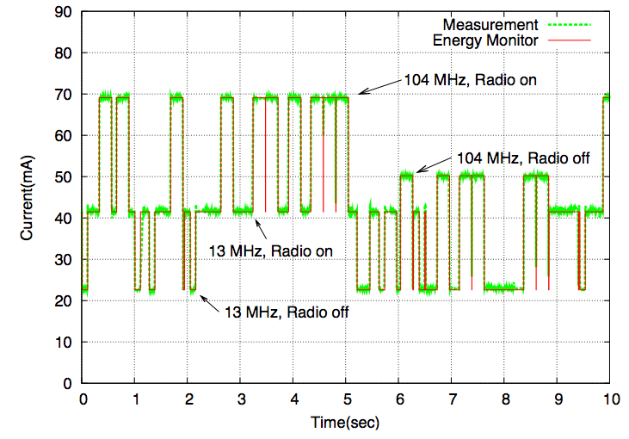
Software energy metering
Energy estimation performed in software
Tracks state of each hardware device (CPU, radio, flash, sensors) in real time
Accurate empirical model of hardware energy consumption (about 2-3% error)
Low overhead, no hardware support required.

Slide 53
Other Energy Brokers
Energy-aware switch
Sends data down one or more downstream paths based on energy availability
Mimics policy used by Eon [Sorber et al., Sensys 2007]
Expensive
operation
Data source
Energy switch
Moderate
operation
tickets
Cheap
operation
Default energy
broker
tickets
Energy Allocator
Energy Estimator

Slide 54
Other Energy Brokers
Energy-aware filter
Selectively drops data to meet energy target
Effectively controls scheduling and duty-cycling of downstream stages
Data source
Energy filter
Downstream
stages
…
tickets
Drop data
Default energy
broker
tickets
Energy Allocator
Energy Estimator

Slide 55
Bandwidth Adaptation in the Motion Analysis Application
Goal: Adapt type and quantity of data transmitted by each node as link quality varies
Don’t want to transmit data that won’t get to the base station.
Uses Pixie’s bandwidth broker
Multiple data types with associated cost and app-assigned value
Estimate available link bandwidth
Assign bandwidth tickets to maximize value subject to bandwidth limit
Type | Bandwidth | Value
Raw samples | 20 pps | 100
RMS | 6 pps | 20
Peak Amp. | 4 pps | 10
Autocorrelation | 2 pps | 5

Slide 56
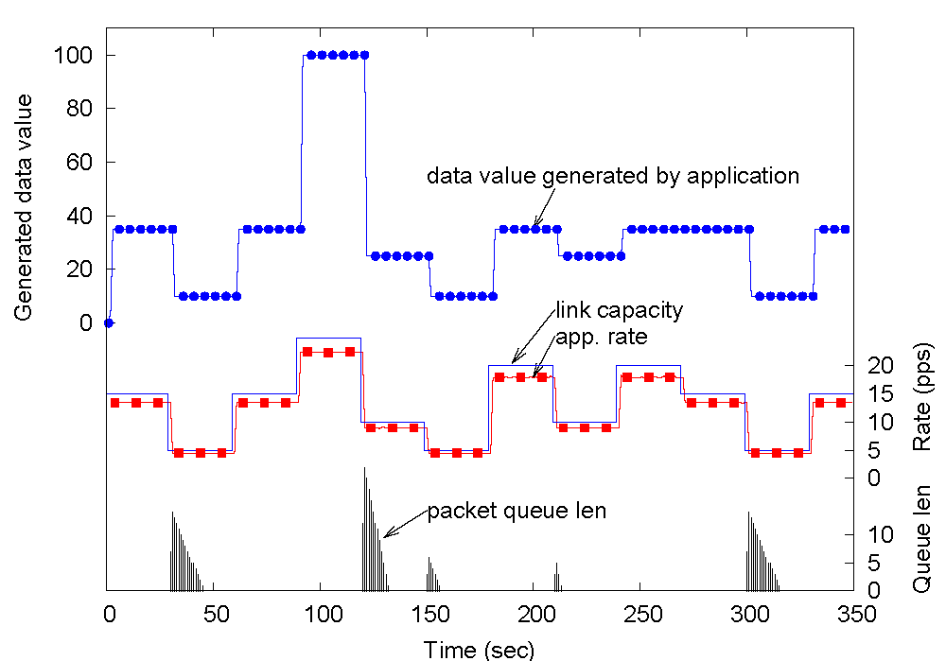
Experiment: Bandwidth Adaptation
Raw samples
Type | Bandwidth | Value
Raw samples | 20 pps | 100
RMS | 6 pps | 20
Peak Amp. | 4 pps | 10
Autocorrelation | 2 pps | 5
Combination of features
Bandwidth estimator is very accurate
Spikes in Tx queue when bandwidth drops

Slide 57
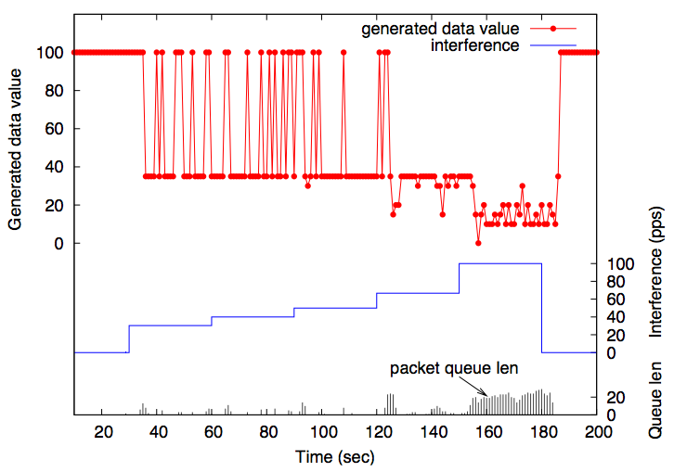
Adaptation to radio channel interference
Gracefully degraded data value
Increasing packet congestion

Slide 58
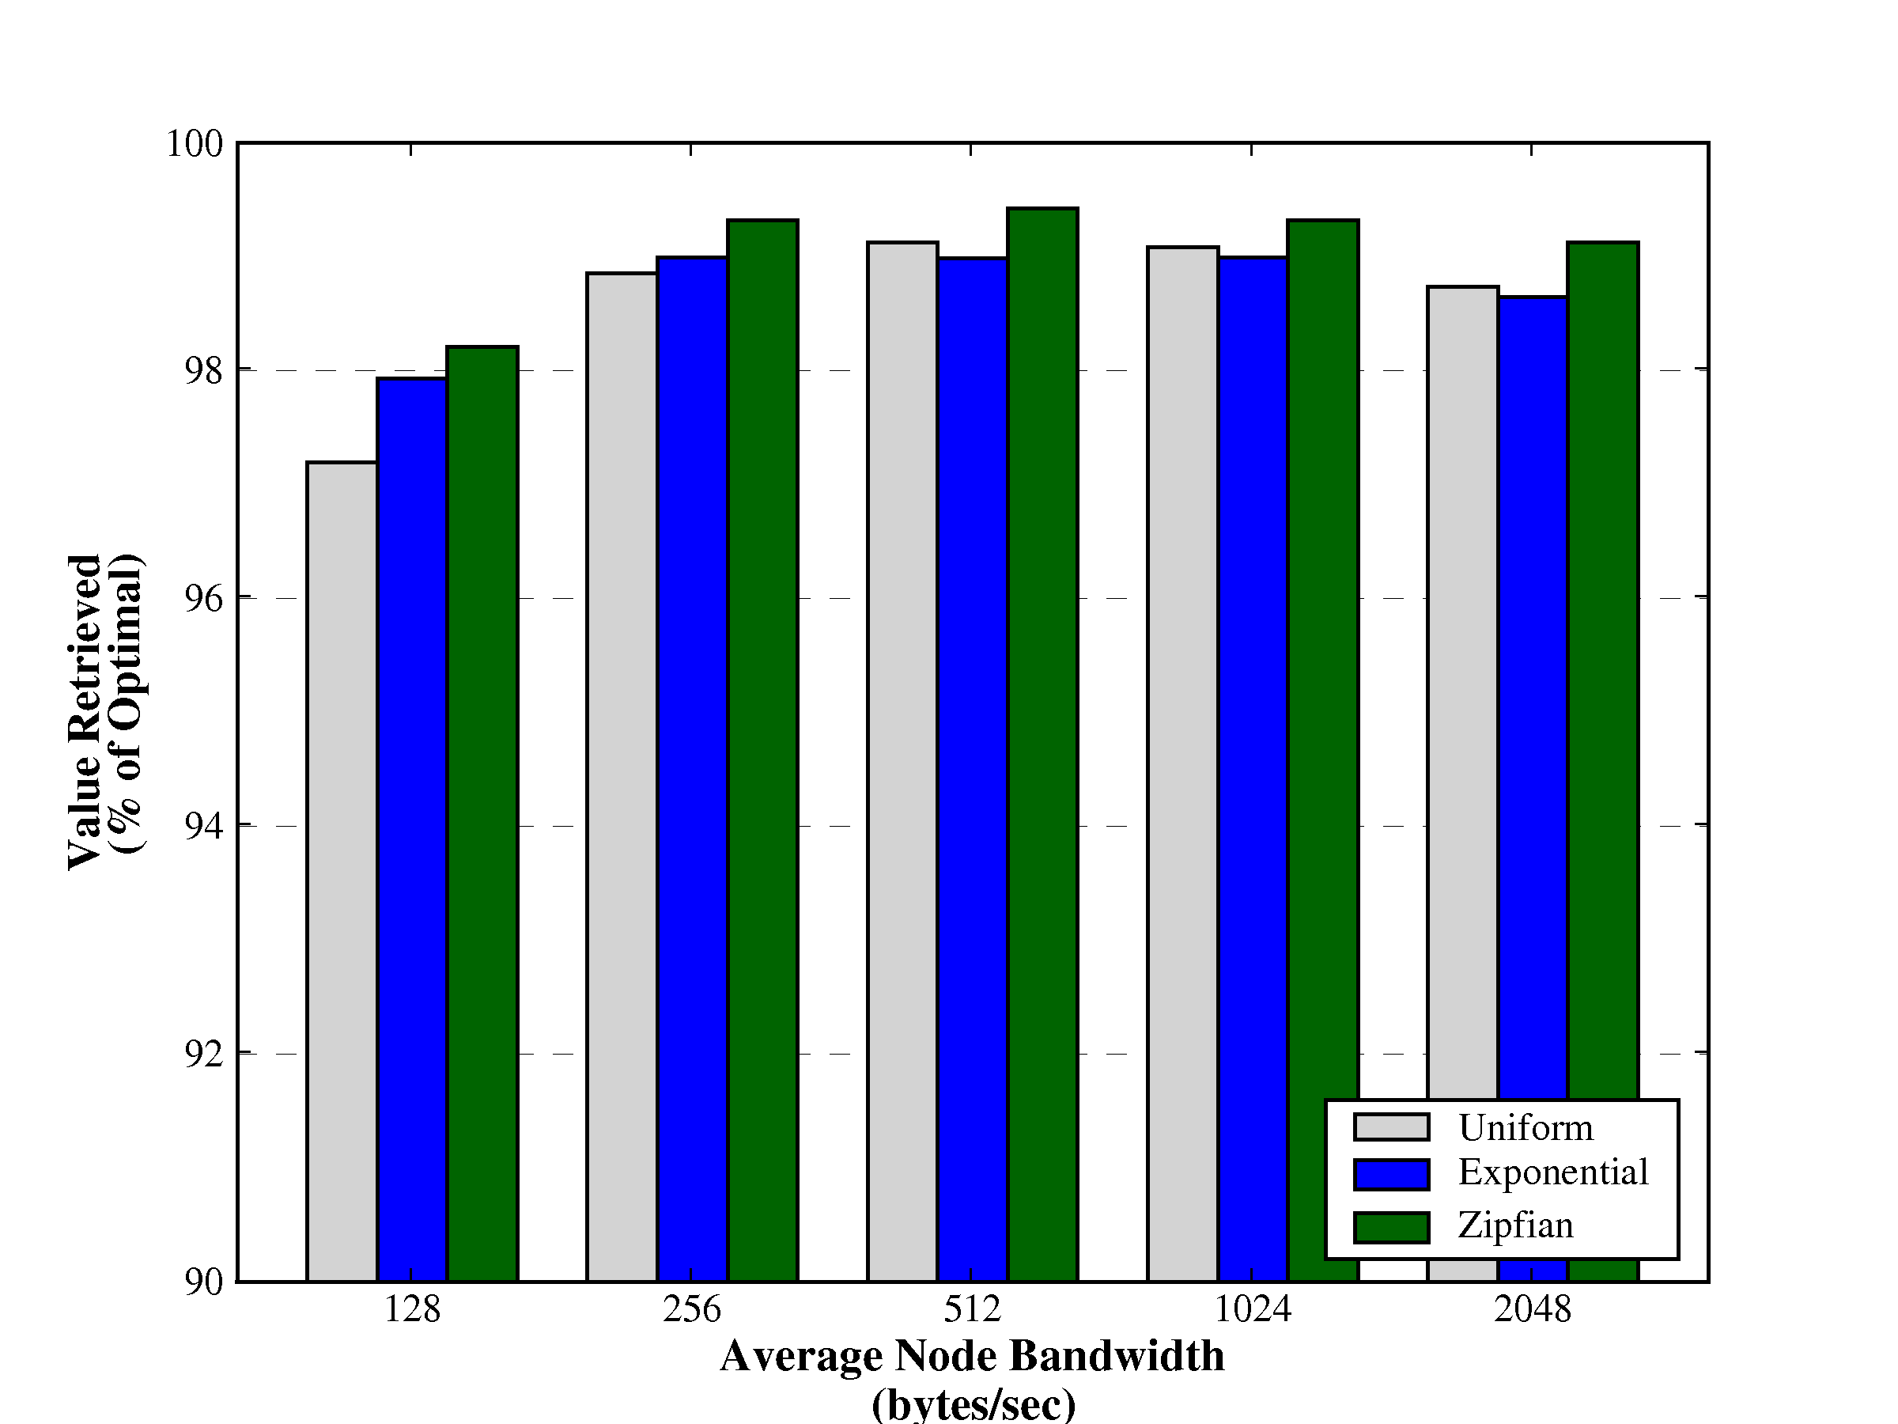
Varying Data Value Distribution
Above 96% in all cases

Slide 59
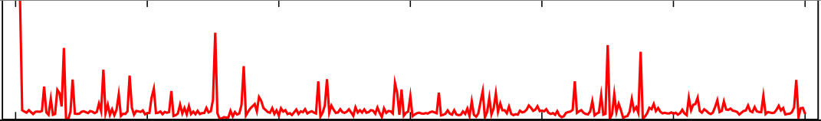
Defining Data Value
Assumption: nodes compute initial value for each ADU.
This determination is inherently app-specific
Raw signal
Short-term
average
divided by
long-term
average

Slide 60
Lance Policy Modules
User-supplied functions to inspect, filter, or modify raw ADU priorities at the base station.
Composed into a linear chain:
Take stream of ADU priorities as input, emit (possibly modified) priorities as output
Can maintain internal state
Must run efficiently (i.e., keep up with stream of ADU priorities from the network).
remove
noise
normalize
filter
<threshold
storage
summaries
download
priority

Slide 61
Example Policy Modules
Priority thresholding
filter: Drop ADU if value below threshold
Noise removal and calibration
adjust: adjust raw value by adding or subtracting fixed offset
debias: normalize data values across nodes
Priority dilation
timespread: assign high ADU values to ADUs adjacent in time
spacespread: assign high ADU values to ADUs sampled by different nodes
Cost weighting
costweight: scale ADU value by cost to download

Slide 62
Example: Correlated Event Detection
correlated policy module W(k,δ)
counts number of ADUs within a time window δ with a nonzero value
if at least k ADUs match, retain ADUs in the window
otherwise, drop this set of ADUs
Network-wide earthquake detection in Lance:
Policy implemented at the base station, rather than on motes.
Easy to modify behavior of network just by changing policy modules.
filter
(threshold)
correlated
(k,δ)
spacespread

Slide 63
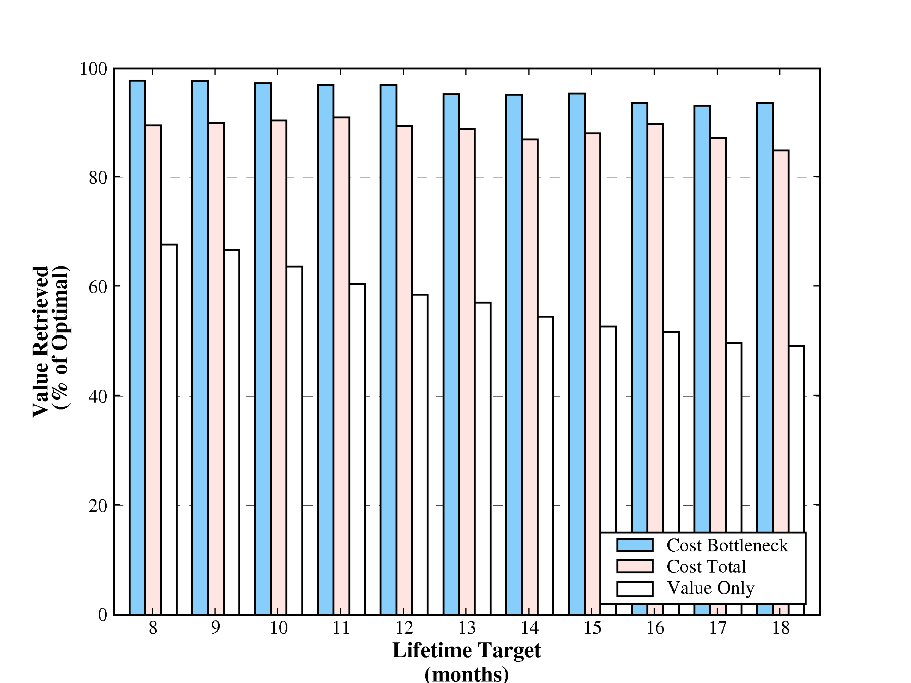
Results under varying lifetime target 25-node tree, Zipf value distribution
Cost bottleneck achieves > 95% optimality across a wide range of target lifetimes

Slide 64
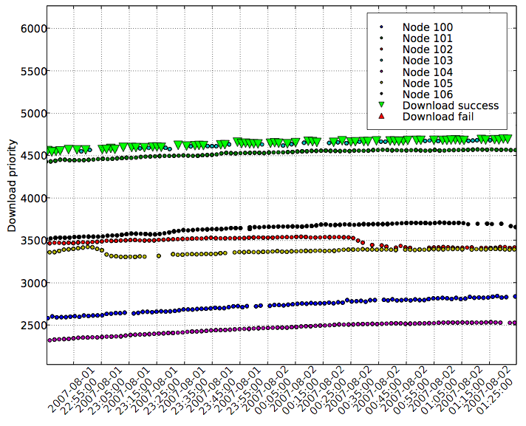
RSAM prioritization: DC bias
RSAM values exhibited large DC bias across nodes.
Lance only downloaded data from 1 or 2 nodes!

Slide 65
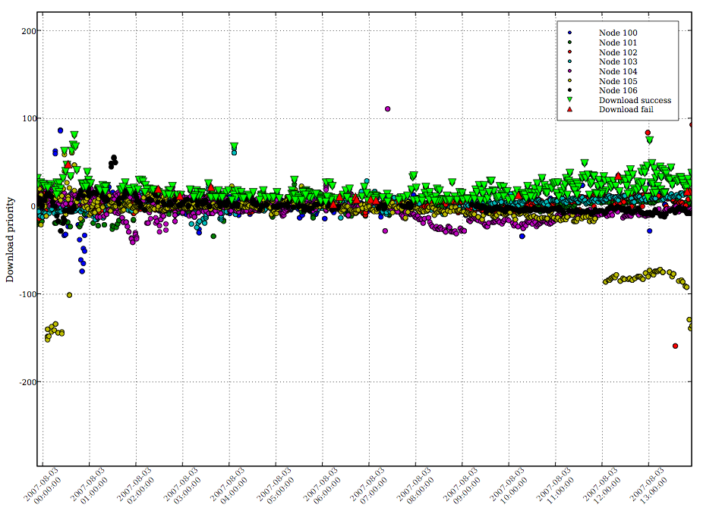
The fix: Debiasing policy module
Median debiasing filter run at base station normalizes RSAM values

Slide 66
Programming Benefits
Dataflow programming model maps well onto application structure
Similar to Eon, Tenet, WaveScope, and Flask
Tickets offer a great deal of flexibility and power
Fine-grained feedback and control of resource usage at all levels
Brokers decouple resource management policies from mechanisms
Enables composable resource adaptations
Resource-awareness is pervasive in the programming model
Not “off to the side”
Annoying at first, but makes sense when you get used to programming in this way
Exposes resource dependencies, rather than relying on hidden magic knobs

Slide 67
Key Research Questions

Slide 68
Our Approach

Slide 69
Today’s Talk

